Slide 1
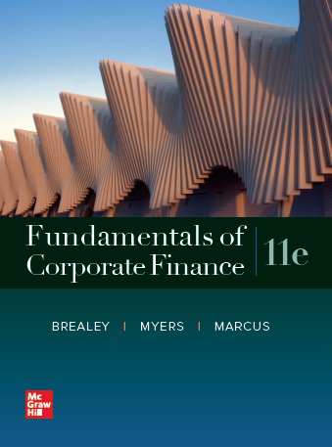
Fundamentals of Corporate Finance, 11th Edition
CHAPTER 6: Valuing Bonds
© McGraw Hill LLC. All rights reserved. No reproduction or distribution without the prior written consent of McGraw Hill LLC.

Slide 2
Bond Rates of Return 1
Rate of Return.
Total income per period per dollar invested.

Slide 3
Bond Rates of Return 2
Example.
A bond increases in price from $963.80 to $1,380.50 and pays a coupon of $21.875 during the same period. What is the rate of return?

Slide 4
Bond Rates of Return 2
Example.
See White Board for another example

Slide 5
Nominal and Real Rates of Interest 1
In the presence of inflation, an investor’s real interest rate is always less than the nominal interest rate.

Slide 6
Nominal and Real Rates of Interest 2
Example.
If you invest in a security that pays 8% interest annually and inflation is 4%, what is your real interest rate? (How much additional Purchasing Power do you have?)

Slide 7
First Half Review/Exam Preview
Chapters 5 & 6; Exam One discussion
See Review Document

